Slide 1

Predictive and Prescriptive Data Analytics for Enhancing Security Decisions in Network Management
Done by: Ahmad Obeid
ID: 21110079
Date: september 12, 2023

Slide 2
Predictive Analytics

Slide 3
Predictive Used Features Selection Techniques
Select from model: A predictive model is trained on the dataset using this feature selection technique, and the most crucial features are then chosen based on the model's assessment of feature relevance.
RFE: It is a feature selection technique that gradually raises the performance of the model by painstakingly removing the dataset's least important characteristics. According to the procedure, each feature is then evaluated for importance depending on how much it adds to the model's performance after an initial model has been trained on the complete dataset.

Slide 4
Predictive Used regression models
Linear regression: By fitting a linear equation to the observed data, it is a straightforward statistical technique for modeling the connection between a dependent variable and one or more independent variables. Finding the line that best fits the data points is the core notion.
Decision tree: It is a non-linear regression technique that generates predictions using a tree-like topology. It divides the data into smaller sections depending on the predictor values and gives each leaf node a constant value.
Random forest: It is an ensemble learning technique that integrates various decision trees to provide predictions that are more reliable and accurate. On various subsets of the data, the random forest model creates several trees, averaging their predictions.

Slide 5
Feature Selection Techniques
Technique name | The selected features
SFM (LR) | event, rest_energy, hop_count, dest_seq_num, src_node_id, src_seq_num, behavior, energy_consumption
SFM (DT) | event, rest_energy, hop_count, dest_seq_num, src_node_id, src_seq_num, Source_IP_Port, S_Node
SFM (RF) | Dest_Node_Num, rest_energy, hop_count, dest_seq_num, src_node_id, src_seq_num, Source_IP_Port, S_Node
RFE (all models) | event, rest_energy, hop_count, dest_seq_num, src_node_id, src_seq_num, behavior, energy_consumption, dest_node_num, source_IP_port, Mac_type_pckt, S_node, packet_size, type, rate_of_energy_consumption

Slide 6
Compare Regression Techniques
Tech. name | Model name | MSE | MAE | RMSE | R2
SFM | LR | 13.51860 | 1.63122 | 3.67671 | 58.45039
SFM | DT | 0.00641 | 0.00029 | 0.05820 | 99.98028
SFM | RF | 0.00412 | 0.00046 | 0.05707 | 99.98732
RFE | LR | 12.64465 | 1.63911 | 3.55587 | 61.13656
RFE | DT | 0.00736 | 0.00033 | 0.06512 | 99.97742
RFE | RF | 0.00426 | 0.00050 | 0.05778 | 99.98689

Slide 7
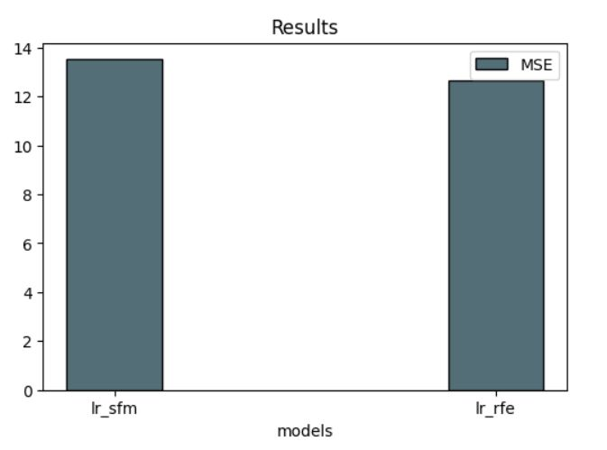
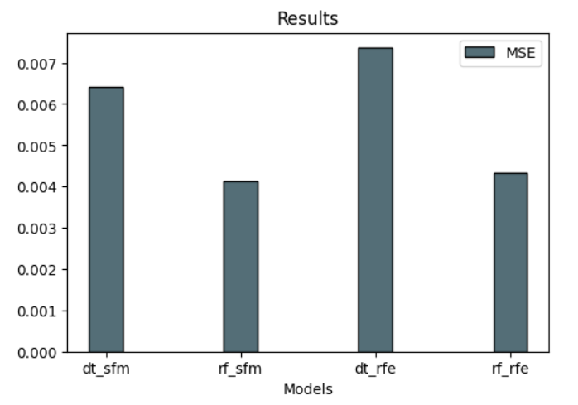
Visualization of results

Slide 8
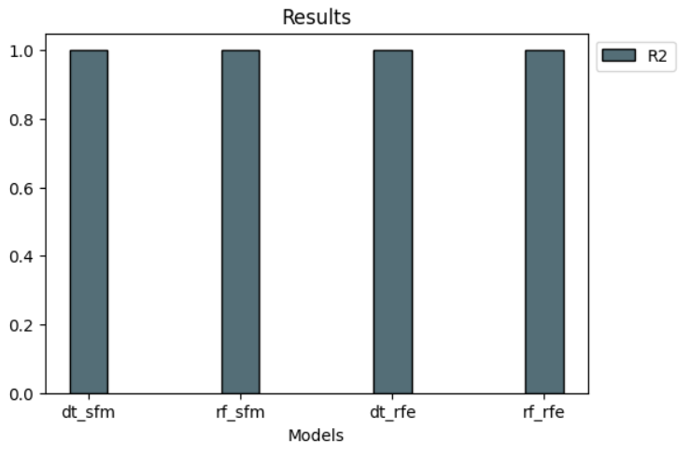
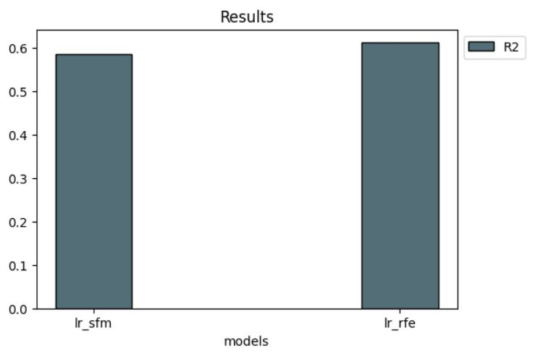
Visualization of results

Slide 9
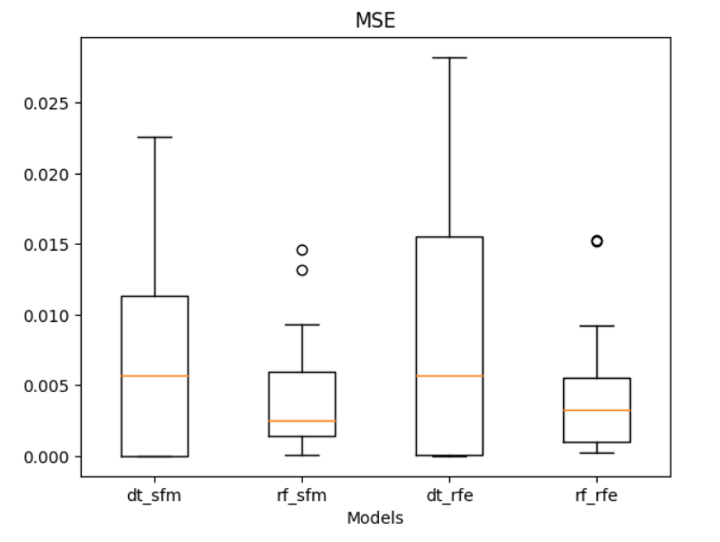
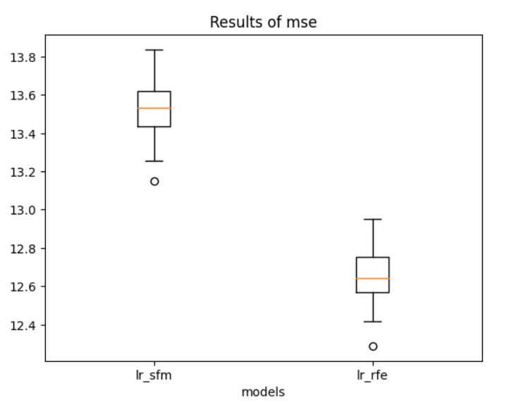
Visualization of results

Slide 10
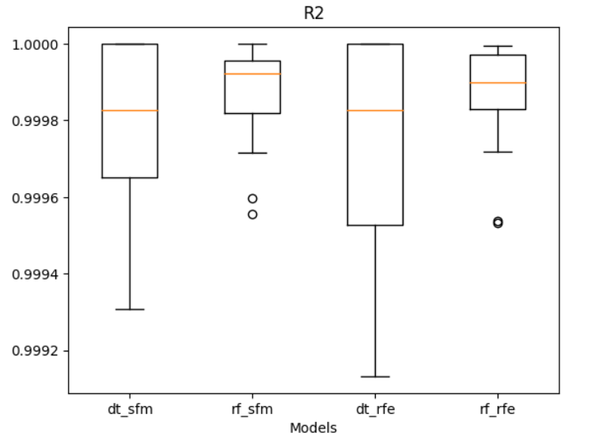
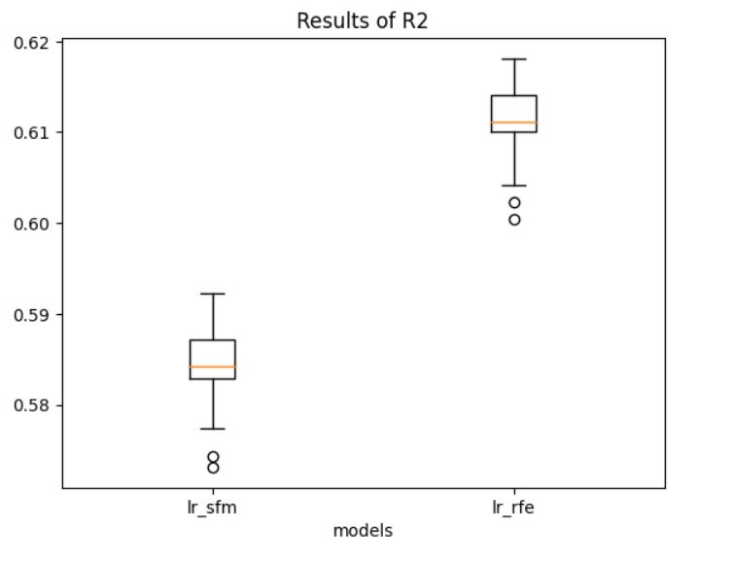
Visualization of results

Slide 11
Evaluation your work in the predicative analytics
Depending on the prediction result and the comparison between select from model and recursive feature elimination techniques, we can see that overall, select from model technique is better than recursive feature elimination and that is because SFM is selecting the most significant features and provide better outcomes. We said that SFM is better than RFE, but only in linear regression model case, RFE is defeating SFM. RFE works in elimination way, which mean it eliminate the least important feature, but I determined 15 as the selected feature number for this techniques, and by the way it was all the features in the dataset after I dropped some columns. Those were the limitations in prediction process.

Slide 12
Evaluation your work in the predicative analytics
The best model was random forest with highest R2 average, and the worst model was linear regression with lowest R2 average. The linear regression model was the worst model because of how it work, it assumes that predictors and target have a linear relationship, which may not be appropriate for all types of data. Additionally, it could miss complex, non-linear patterns. On the other hand, random forest was the best model on both techniques, because of it work nature its properties which are handling the categorical and numerical data, being resilient to outliers, and produce feature relevance scores, which all that lead to very high R2 value. There is a potential improvement to get better result, which is to use other feature selection techniques that might make the result better. Also, we can use other models instead of random forest model since its the best model and maybe we will get better outcomes.

Slide 13
Prescriptive Analytics

Slide 14
Prescriptive Analytics Techniques
Dynamic programming
To solve issues, dynamic programming divides them into smaller subproblems, solves each subproblem only once, and stores the solutions to prevent repeating calculations.
When a problem may be divided into overlapping subproblems, like in scheduling, resource allocation, and optimization, dynamic programming is frequently utilized. It assists in determining the optimum course of action by methodically weighing all viable options, figuring out the value or cost associated with each option, and then choosing the best order of options to maximize or reduce a particular objective function.
Numerous disciplines, such as economics, operations research, and computer science (such as algorithm optimization), heavily rely on dynamic programming. Additionally, it is utilized in engineering for resource allocation and in finance for portfolio optimization.

Slide 15
Prescriptive Analytics Techniques
Fuzzy logic system
A computing method known as fuzzy logic uses variables with degrees of membership in a set rather than binary (true/false) values to deal with uncertainty and imprecision.
When the criteria and decision elements are not clearly specified, fuzzy logic systems are utilized to determine the optimal course of action. A fuzzy logic system can produce suggestions that take into consideration the ambiguity and uncertainty present in some problems by employing fuzzy rules and giving different elements degrees of membership.
Applications for fuzzy logic can be found in fields like control systems (such as regulating HVAC system temperature) and image processing (such as edge identification). For risk assessment and decision-making in ambiguous situations, it is also utilized in decision support systems.

Slide 16
Prescriptive Analytics Techniques
Rule-based system
The conditional statements that make up the rule-based system's structure define how decisions should be made in response to particular situations or inputs.
Rule-based systems are used to choose the best course of action by applying a set of rules to the current situation or data. Each rule assesses the circumstances and suggests a course of action or choice. To arrive at a final judgment, the system incorporates the recommendations from various regulations.
Expert systems use rule-based systems to diagnose medical issues and solve technical issues. They assist in commercial decision-making in areas like marketing and credit rating. Rule-based systems are often used in manufacturing for process and quality improvement.

Slide 17
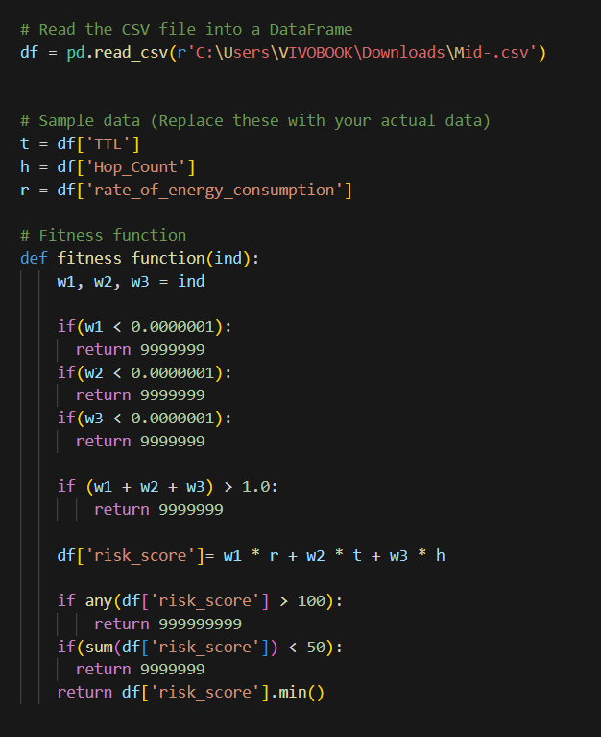
Objective Function Code (Your Work)

Slide 18
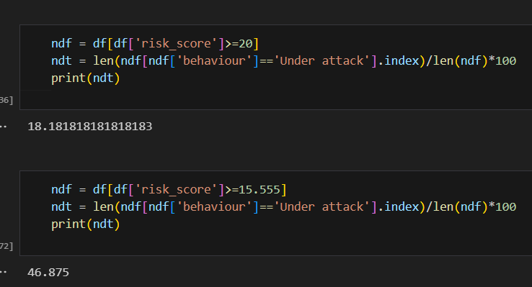
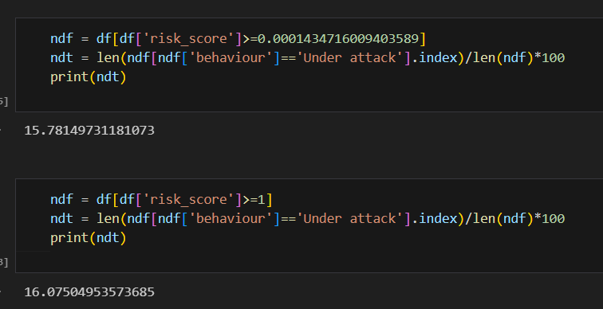
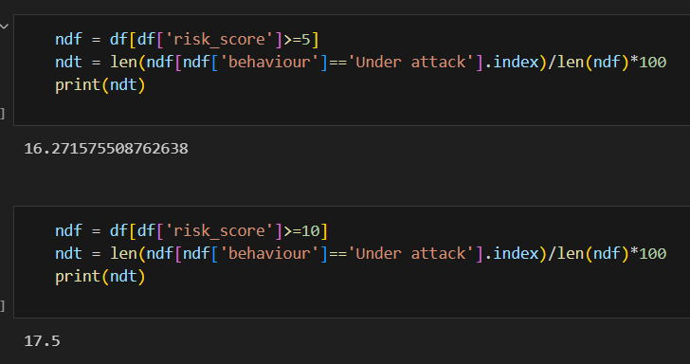
Results and Explanation

Slide 19
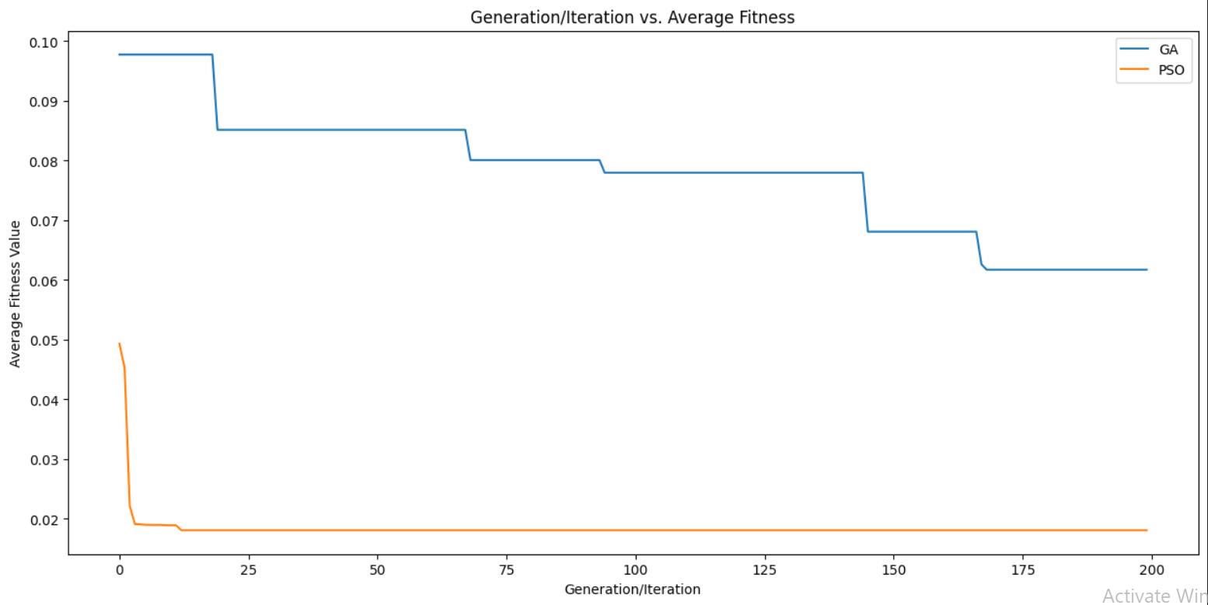
Visualization and Explanation

Slide 20
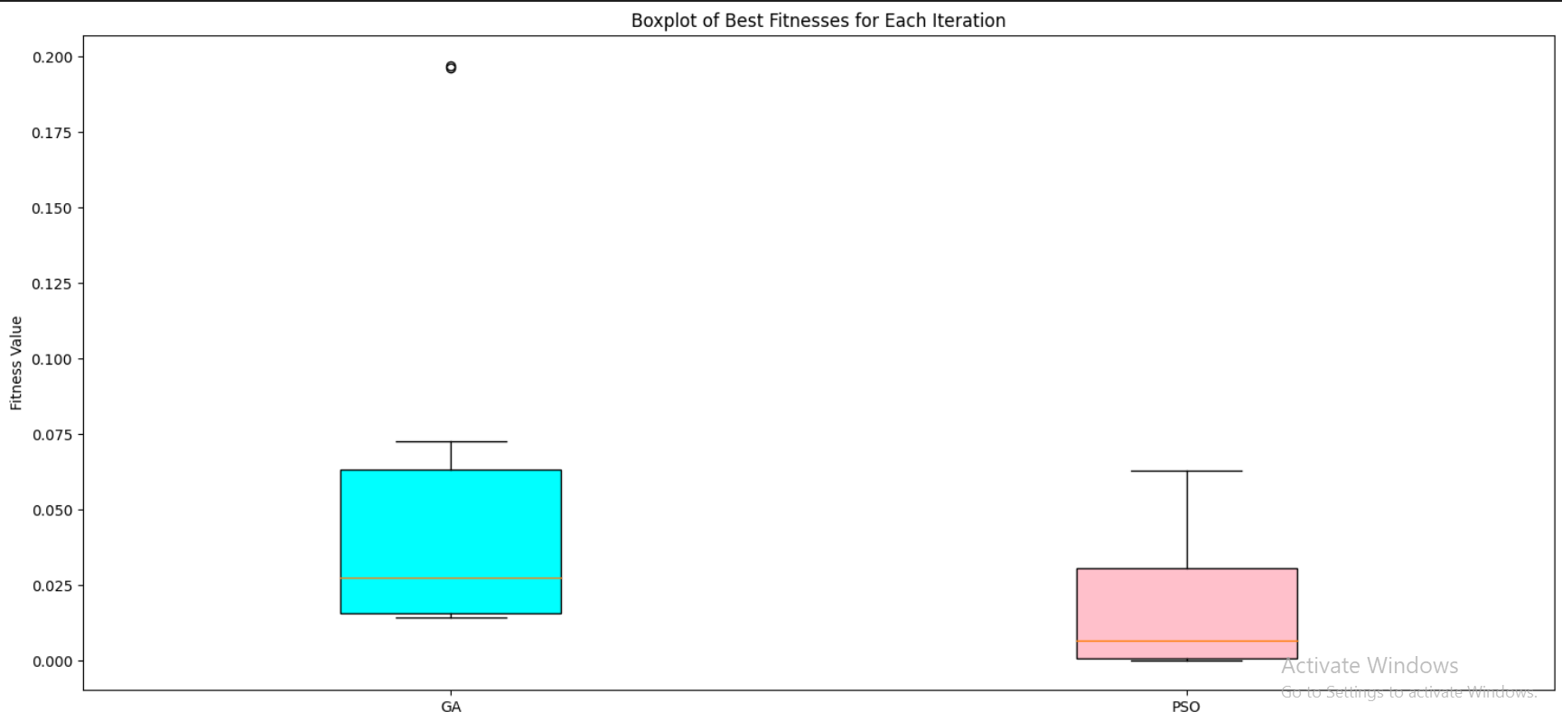
Visualization and Explanation

Slide 21
Visualization notes
PSO reached the best fitness value
GA has many changes unlike PSO
GA value range and average is larger

Slide 22
References
Recursive features elimination: Working, Advantages & Examples (May 2023) Analytics Vidha. Available at: https://www.analyticsvidhya.com/blog/2023/05/recursive-feature-elimination/ (Accessed: 4 September 2023).
When to choose linear regression or Decision Tree or Random Forest regression? (April 2010) Data science stack exchange. Available at: https://datascience.stackexchange.com/questions/9159/when-to-choose-linear-regression-or-decision-tree-or-random-forest-regression (Accessed: 4 Semptember 2023).
Fozzy logic: introduction (Jan 2023) GeeksforGeeks. Available at: https://www.geeksforgeeks.org/fuzzy-logic-introduction/ (Accessed: 4 September 2023).
Fuzzy rule-based systems (Jan 2010) SpringerLinks. Available at: https://link.springer.com/chapter/10.1007/978-3-662-43505-2_13 (Accessed: 4 September 2023).

